Slide 1
Tournament Schedule
University of Toronto
Mechanical and Industrial Engineering
By Group 1
Dalin Cheng 1002149329
Yuejun Lu 1002438016
Junyu Jiang 1002916561

Slide 2


Introduction
English Premier League

Slide 3
Problem Definition
Main Purpose:
Make the tournament schedule of the English Premier League with minimum total travel distance for all teams.

Slide 4
Problem Definition
Restrictions:
There are m teams in total. (m is always an even integer).
There are (m-1) rounds of games, and every club plays games in each round.
Each club plays (m-1) games in total.
Each club has only 1 game in one round.
Each club has games with each other once, one plays home game and another club plays away game.

Slide 5
Problem Definition
Club Round | Round1 | Round2 | … | Round (m-1)
1 | 2 | 3 | … | m
2 | 1 | 5 | … | 9
3 | 7 | 1 | … | 8
… | … | … | … | …
m | 10 | 11 | … | 1

Slide 6
Mathematical Model
Mixed integer linear programming(MILP):
Notations:
T: The set of all teams [0, m-1]
R: The set of all rounds [0, m-2]
Dij: Distance between the venue of team i and team j
Cip: Distance team i needs to travel between round p and round p+1
Xip: Equals 1 if team i plays home game in round p, 0 if plays away game
Zijp: Equals 1 if team i and team j play game together in round p, 0 if not
L: Sum of total distance all teams need to travel throughout the whole game

Slide 7
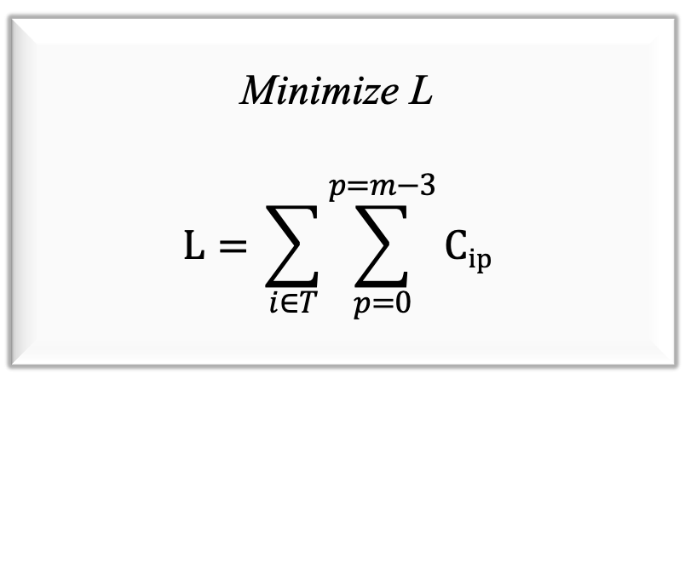
Mathematical Model
Optimize objective:
Minimize L
$$L={\sum_{i∈T}{\sum_{p=0}^{p=m−3}{Cip}}}$$

Slide 8
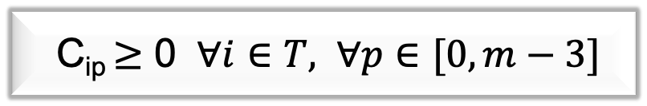
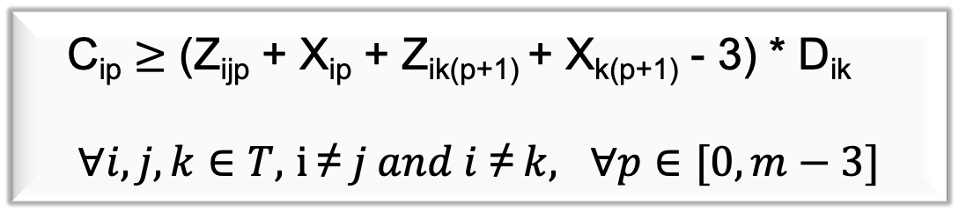
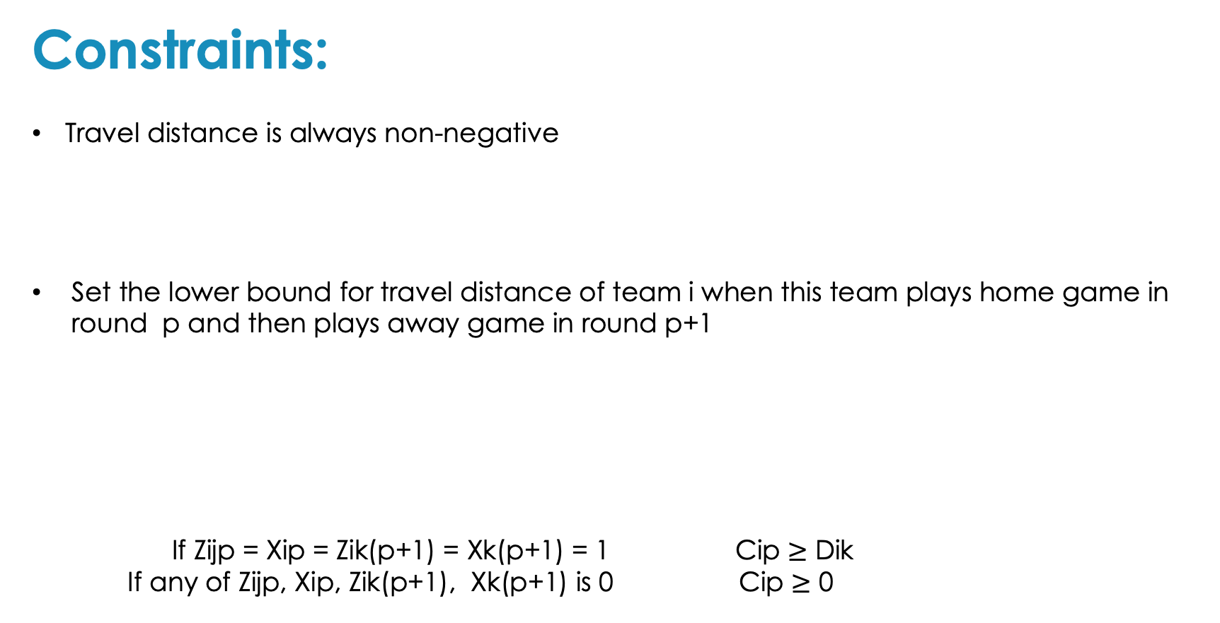
Mathematical Model
Constraints:
Travel distance is always non-negative
Set the lower bound for travel distance of team i when this team plays home game in round p and then plays away game in round p+1
If Zijp = Xip = Zik(p+1) = Xk(p+1) = 1 Cip $≥$ Dik
If any of Zijp, Xip, Zik(p+1), Xk(p+1) is 0 Cip $≥$ 0
C_{ip} $≥$ 0 $∀i∈T,$ $∀p∈[0, m−3]$
C_{ip} $≥$ (Z_{ijp} + X_{ip} + Z_{ik(p+1)} + X_{k(p+1)} - 3) * D_{ik}
$∀i, j,k∈T,$ $i \text{≠} j and i\text{ ≠} k, ∀p∈[0, m−3]$

Slide 9
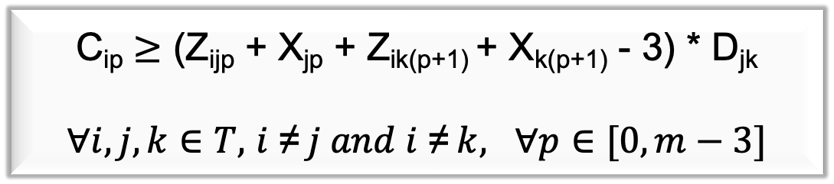
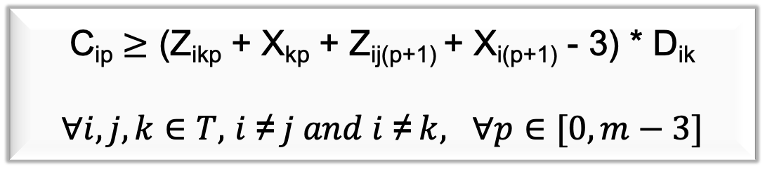
Mathematical Model
Constraints:
Set the lower bound for travel distance of team i when this team plays away game in round p and then plays home game in round p+1
Set the lower bound for travel distance of team i when this team plays away game in round p and then plays away game in round p+1
C_{ip} $≥$ (Z_{ikp} + X_{kp} + Z_{ij(p+1)} + X_{i(p+1)} - 3) * D_{ik}
$∀i, j,k∈T,$ $i \text{≠} j and i\text{ ≠} k, ∀p∈[0, m−3]$
C_{ip} $≥$ (Z_{ijp} + X_{jp} + Z_{ik(p+1)} + X_{k(p+1)} - 3) * D_{jk}
$∀i, j,k∈T,$ $i \text{≠} j and i\text{ ≠} k, ∀p∈[0, m−3]$

Slide 10
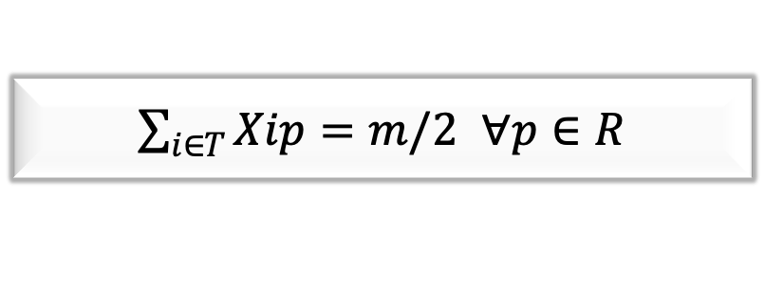
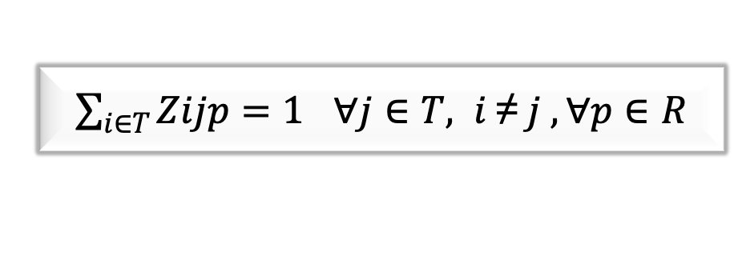
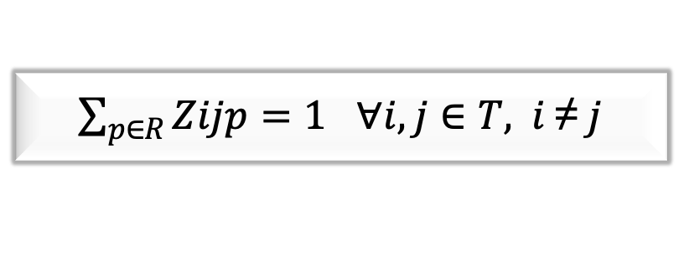
Mathematical Model
Constraints:
Each team plays once with every other team in all rounds.
Each team only plays one game in each round.
Number of total home games played in one round is m/2.
$\sum_{p∈R}{Zijp=1}$ $∀i, j∈T, i \text{≠} j$
$\sum_{i∈T}{Zijp=1}$ $∀j∈T,$ $i \text{≠} j , ∀p∈R$
$\sum_{i∈T}{Xip=m/2}$ $∀p∈R$

Slide 11


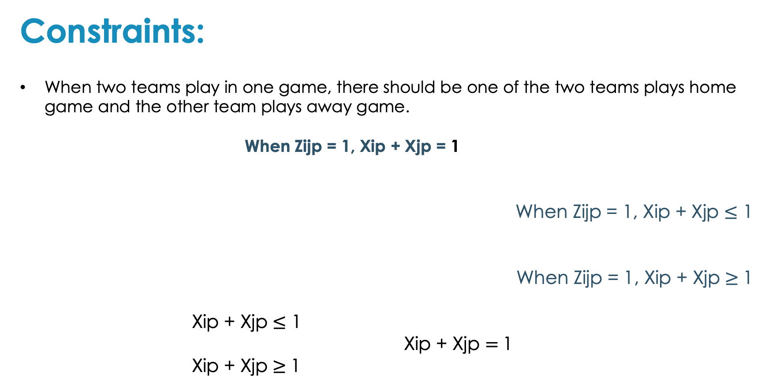
Mathematical Model
Constraints:
When two teams play in one game, there should be one of the two teams plays home game and the other team plays away game.
When Zijp = 1, Xip + Xjp = 1
When Zijp = 1, Xip + Xjp $≤$ 1
When Zijp = 1, Xip + Xjp $≥$1
Xip + Xjp $≤$ 1
Xip + Xjp $=$1
Xip + Xjp $≥$1
Z_{ijp} + X_{ip} + X_{jp} $≤2 ∀i, j∈T$, $i \text{≠} j,∀p∈R$
X_{ip} + X_{jp} $≥$Z_{ijp} $∀i, j∈T$, $i \text{≠} j$, $∀p∈R$

Slide 12
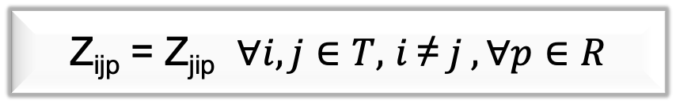


Mathematical Model
Constraints:
Xip and Zijp are binary variables
X_{ip}$∈\{0,1\}$ $∀i∈T$ $∀p∈R$
Z_{ijp}$∈\{0,1\}$ $∀i,j∈T,i \text{≠} j,∀p∈R$
Z_{ijp} = Z_{jip} $∀i, j∈T,$ $i \text{≠} j ,∀p∈R$

Slide 13
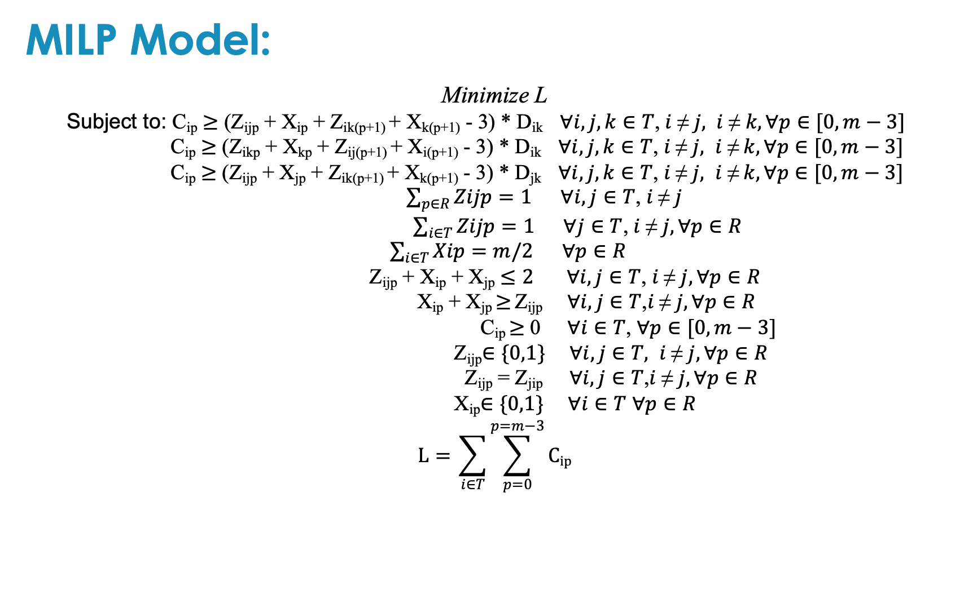
Mathematical Model
MILP Model:
Minimize L
Subject to: C_{ip} $≥$ (Z_{ijp} + X_{ip} + Z_{ik(p+1)} + X_{k(p+1)} - 3) * D_{ik} $∀i, j,k∈T$,$i \text{≠} j, i \text{≠} k, ∀p∈[0, m−3]$
C_{ip} $≥$ (Z_{ikp} + X_{kp} + Z_{ij(p+1)} + X_{i(p+1)} - 3) * D_{ik} $∀i, j,k∈T$, $i \text{≠} j, i \text{≠} k,∀p∈[0, m−3]$
C_{ip} $≥$ (Z_{ijp} + X_{jp} + Z_{ik(p+1)} + X_{k(p+1)} - 3) * D_{jk} $∀i, j,k∈T$, $i \text{≠} j, i \text{≠} k, ∀p∈[0, m−3]$
$\sum_{p∈R}{Zijp=1}$ $∀i, j∈T$, $i \text{≠} j$
$\sum_{i∈T}{Zijp=1}$ $∀j∈T$, $i \text{≠} j, ∀p∈R$
$\sum_{i∈T}{Xip=m/2}$ $∀p∈R$
Z_{ijp} + X_{ip} + X_{jp} $≤2 ∀i, j∈T$, $i \text{≠} j, ∀p∈R$
X_{ip} + X_{jp} $≥$Z_{ijp} $∀i, j∈T$,$i \text{≠} j,∀p∈R$
C_{ip} $≥$ 0 $∀i∈T$, $∀p∈[0, m−3]$
Z_{ijp}$∈\{0,1\}$ $∀i,j∈T, i \text{≠} j,∀p∈R$
Z_{ijp} = Z_{jip} $∀i, j∈T$,$i \text{≠} j,∀p∈R$
X_{ip}$∈\{0,1\}$ $∀i∈T$ $∀p∈R$
$$L={\sum_{i∈T}{\sum_{p=0}^{p=m−3}{Cip}}}$$

Slide 14

General Information
Solver: GUROBI Optimizer 9.0.3 under an academic license performed on Python3.6.5
CPU: intel Core i7-6700k, 4.2GHz, 8MB cache
RAM: 16GB
System: 64-bit Windows

Slide 15
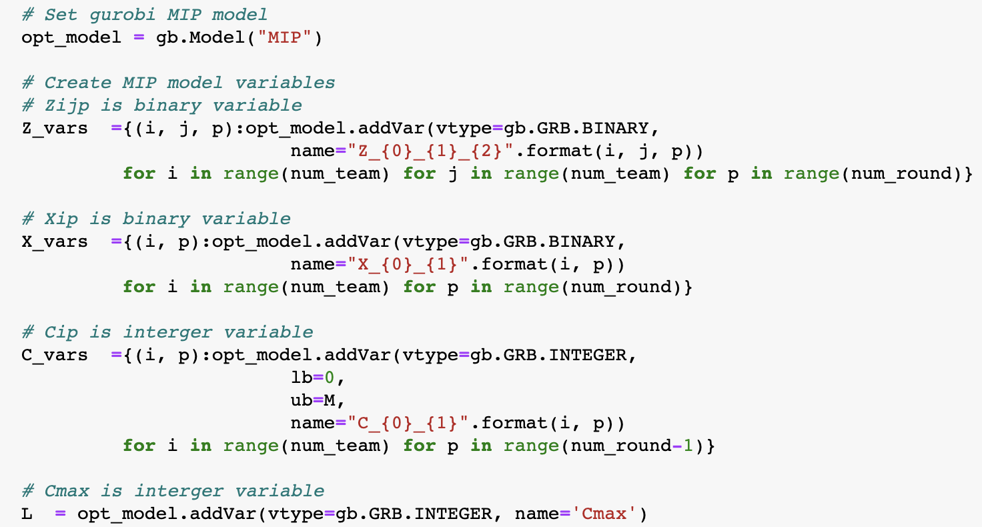
Brief System Demo

Slide 16
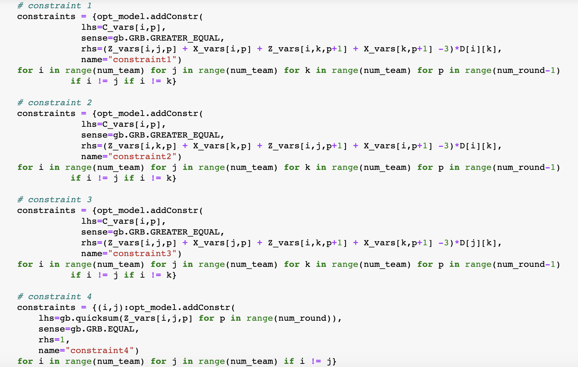
Brief System Demo

Slide 17
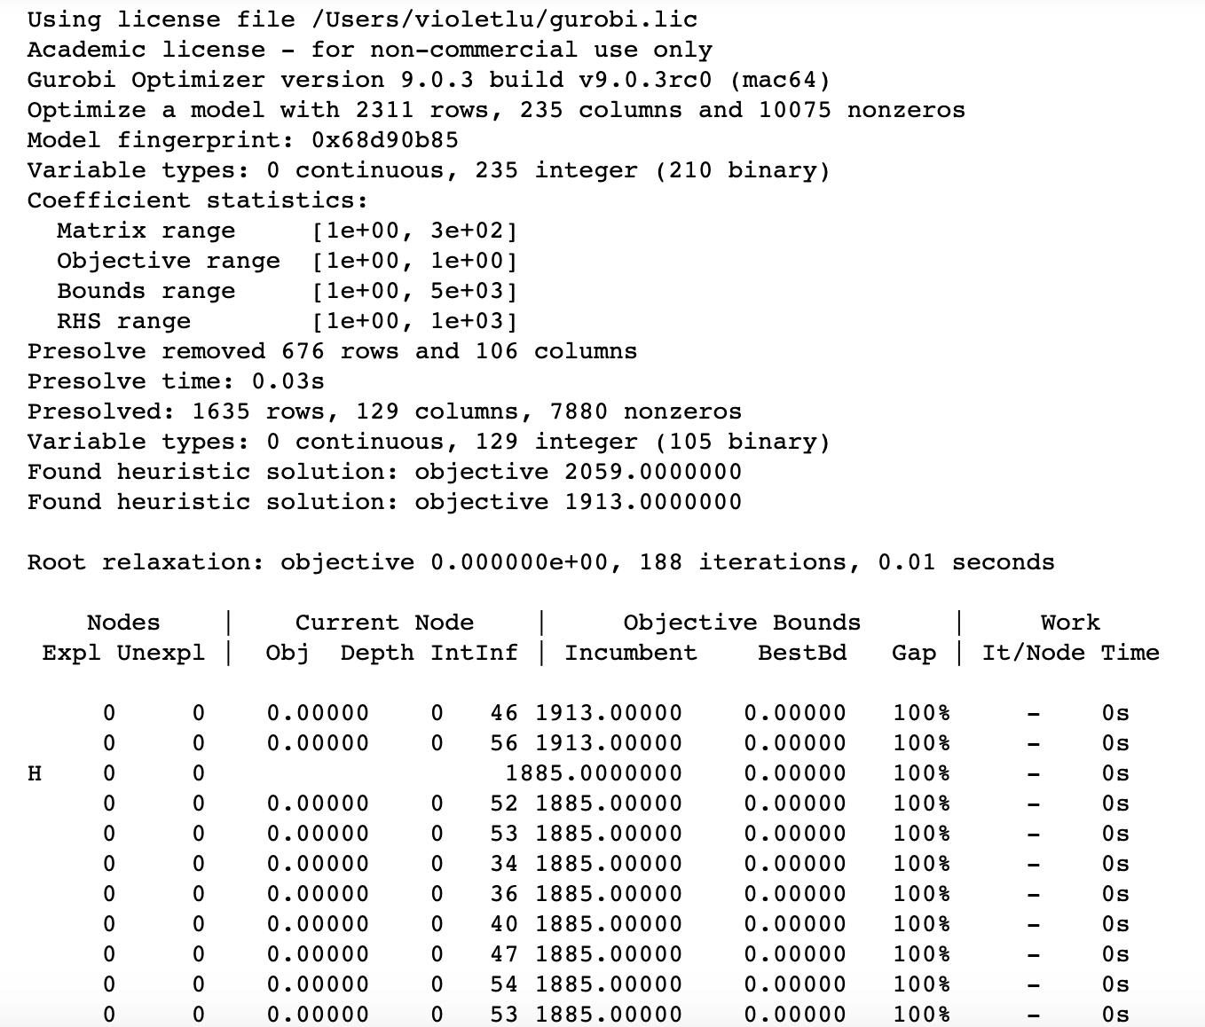
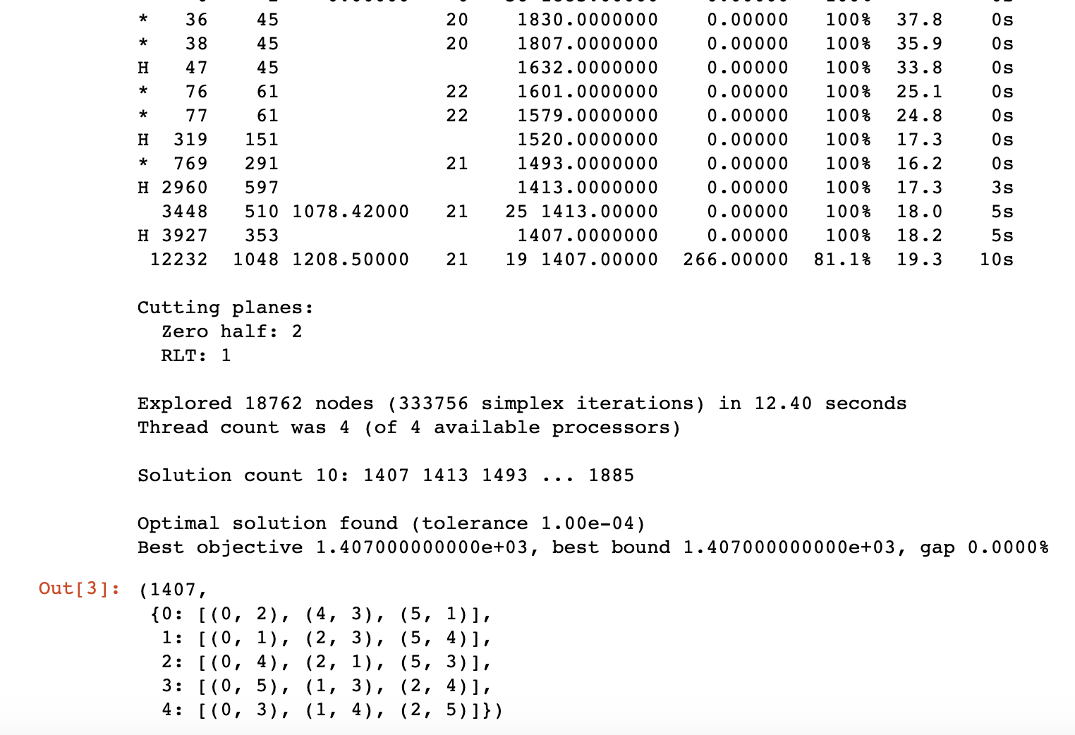
Brief System Demo

Slide 18
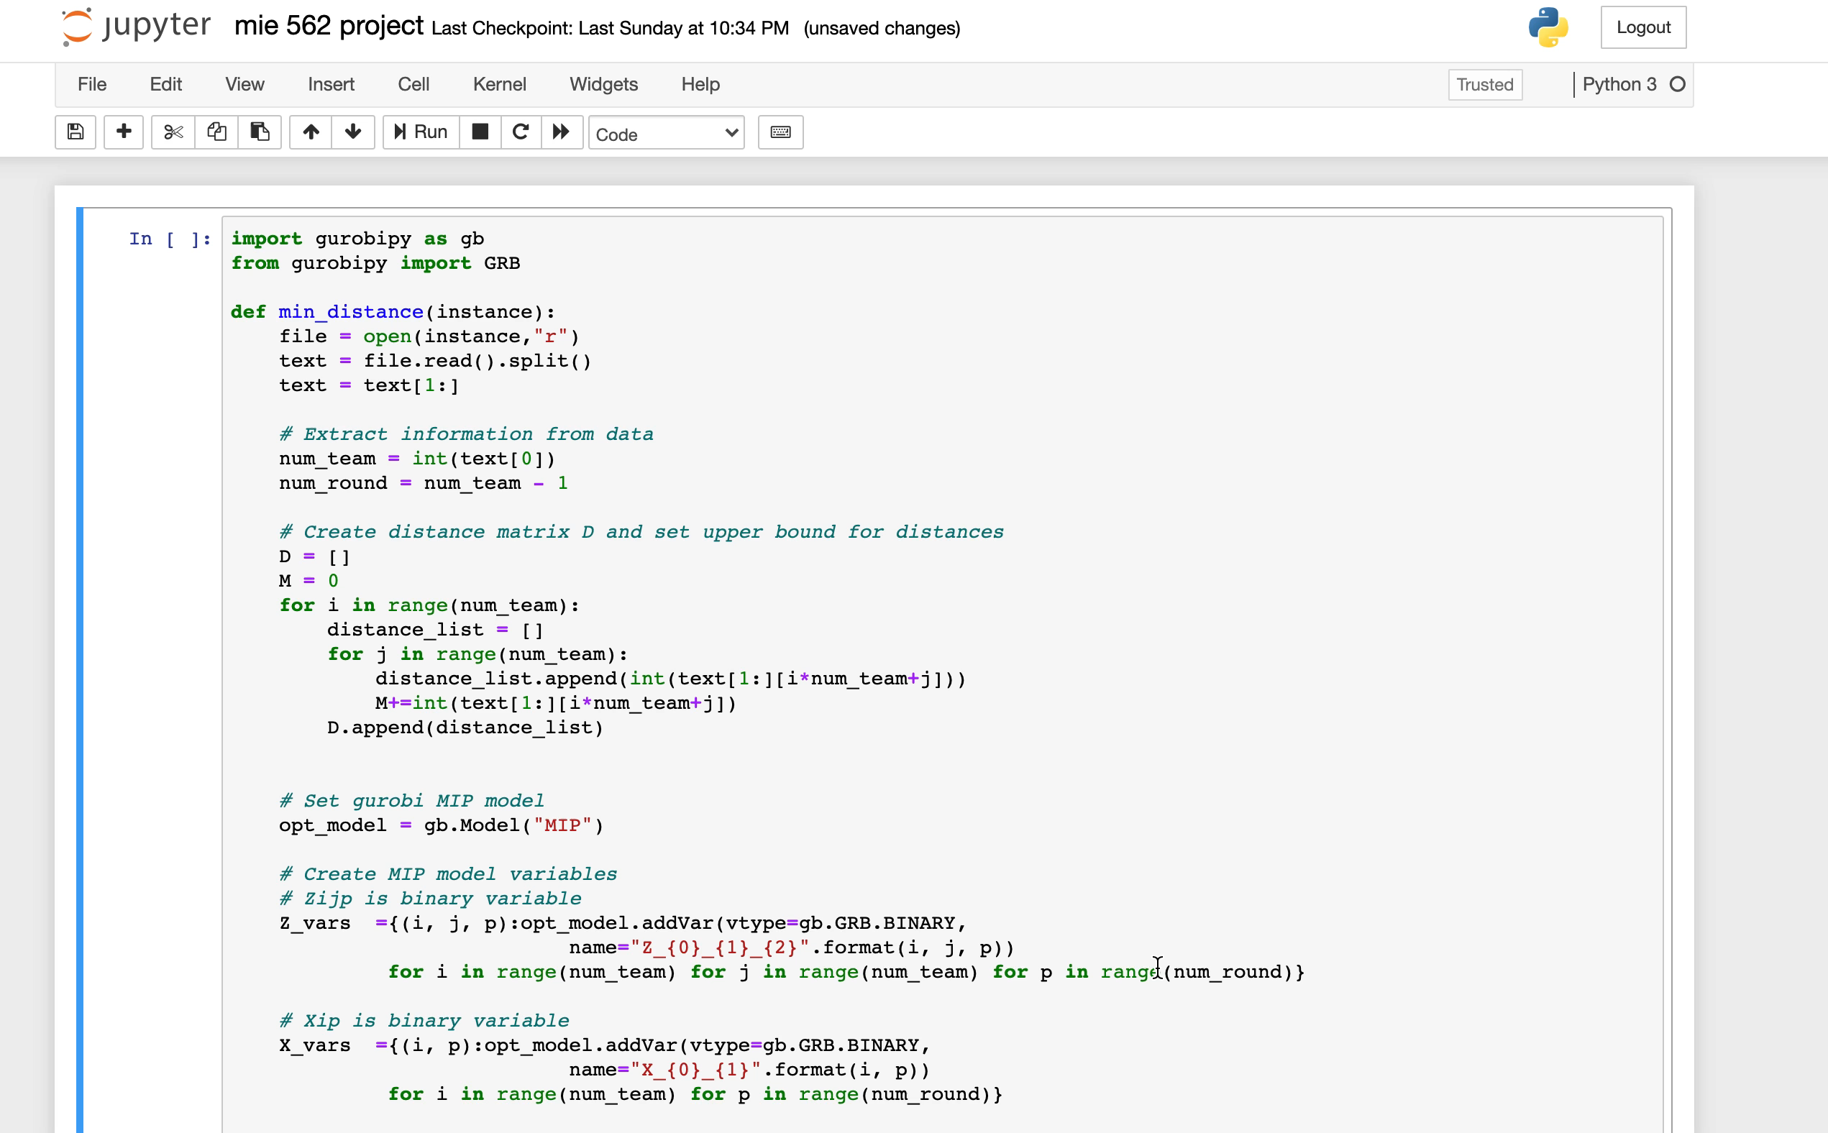

Slide 19
Problem instances
14 problem instances were run : two for 4 teams; ten for 6 teams and two for 8 teams.
Each instance was made up of different combinations of teams.
Designated run-time limit was 10 minutes. Stop the program when the run-time was over 10 minutes.

Slide 20
Result
Index | Club Name | City
0 | Arsenal | London
1 | Aston Villa | Birmingham
2 | Brighton and Hove Albion | Brighton
3 | Burnley | Burnley
4 | Chelsea | London
5 | Crystal Palace | London
6 | Everton | Liverpool
7 | Fulham | London
8 | Leeds United | Leeds
9 | Leicester City | Leicester
10 | Liverpool | Liverpool
11 | Manchester City | Manchester
12 | Manchester United | Manchester
13 | Newcastle United | Newcastle
14 | Sheffield United | Sheffield
15 | Southampton | Southampton
16 | Tottenham Hotspur | London
17 | Wet Bromwich Albion | West Bromwich
18 | West Ham United | London
19 | Wolverhampton Wanderers | Wolverhampton
Instance No. | No. of Team | Teams index from original team table | L (miles) | Runtime (s)
1 | 4 | 7,8,9,10 | 441 | 0.09
2 | 4 | 8,9,10,11 | 249 | 0.10
3 | 6 | 0,1,2,3,4,5 | 459 | 1.75
4 | 6 | 6,7,8,9,10,11 | 663 | 6.25
5 | 6 | 12,13,14,15,16,17 | 1407 | 8.52
6 | 6 | 1,2,3,4,5,6 | 1167 | 2.53
7 | 6 | 2,3,4,5,6,7 | 658 | 1.32
8 | 6 | 3,4,5,6,7,8 | 1222 | 2.51
9 | 6 | 4,5,6,7,8,9 | 792 | 1.72
10 | 6 | 5,6,7,8,9,10 | 1116 | 9.44
11 | 6 | 7,8,9,10,11,12 | 588 | 2.78
12 | 6 | 8,9,10,11,12,13 | 588 | 2.40
13 | 8 | 0,1,2,3,4,5,6,7 | N/A | 881(not completed)
14 | 8 | 12,13,14,15,16,17,18,19 | N/A | 1209 (not completed)

Slide 21
Result Analysis

Slide 22
Conclusion
The model is only suitable for team size below 6.
Mix Integer Linear Programming model for this problem is not efficient enough to solve the problem with a larger team size.

Slide 23
Reference
Wen-Yang Ku, J. Christopher Beck. Mixed Integer Programming Models for Job Shop Scheduling: A Computational Analysis. April 18, 2016.

Slide 24
Contribution
Dailin: Introduction and Problem Definition
Yuejun: Mathematical Model and System Demo
Junyu: Result discussion and Conclusion

